Slide 1
Retirement Income Pensions/Annuities Social Security/Railroad Retirement Benefits/ IRAs/401Ks
Pub 17 Chapter 10 & 11
Pub 4012 Tab D
(1040-Line 16)
(NJ 1040-Lines 19a & 19b)
Notes:
1

Slide 2
Types Of Retirement Income
Pensions & 457 plans
(including disability income post retirement age)
Annuity/Insurance Contracts
Social Security (covered in later module)
Railroad Retirement Benefits
Tier 1 – Social Security equivalent (covered in later module)
Tier 2 – Pension equivalent
IRAs
401k, 403b plans
Notes:
2

Slide 3
Retirement Income Definitions
Pension (including 457 plans):
Periodic payments made to employee (or survivor) after retirement from work
Annuity:
Payments received by taxpayer under contract from insurance company, trust company or individual
IRA (Individual Retirement Account):
Self-managed personal tax-deferred savings plan
401k:
Employer sponsored & managed tax-deferred retirement savings plan (Wages are still subject to SS & Medicare Taxes)
403b:
Retirement savings plan for public education, some non-profit, cooperative hospital service organizations, and self-employed ministers
Notes:
3

Slide 4
IRAs – Individual Retirement Accounts
Different types of IRAs
Traditional IRA
IRA with deductible contributions
IRA with non-deductible contributions
Roth IRA
Simple IRA (Savings Incentive Match Plans for Employees) OUT OF SCOPE when contributions are made
SEP IRA (Simplified Employee Pension) OUT OF SCOPE when contributions are made
Notes:
4

Slide 5
Reporting IRA Contributions to Taxpayer
Custodians/Trustees must issue a form 5498 to report contributions to an IRA
Reports deductible and nondeductible contributions, conversions, rollovers
Separate form 5498 for each IRA account to which contributions were made in a year
Information needed to complete form 8606 for non-deductible contributions

Slide 6
Traditional IRA
Must have earned income & be < 70½ to contribute
Federal rules:
Contributions tax deductible in the year made for Federal
Current limit – $5,500/$6,500 if >/= 50 years of age
May be reduced based on retirement plan, filing status, income
Contributions can be made up to tax return due date & applied retroactively to tax year
Discussed in depth in Adjustments module
Earnings accumulate tax deferred
Distributions taxable in the year received
NJ rules:
Contributions to IRA are not deductible in the year made
Therefore, contributions may not be taxable when distributed
Earnings accumulate tax deferred, but earnings taxed when distributed
Required Minimum Distribution (RMD) by April 1 following year taxpayer turns 70½ (or 50% penalty)
If born on or before 6/30 - Take RMD by 12/31 of that year, to avoid having to take double RMD the next year
Notes:
6

Slide 7
Traditional IRA with Non-Deductible Contributions
Non-deductible contribution is difference between permitted contribution and amount allowed for IRA deduction
Alternative when IRA deduction is limited due to retirement plan, income, filing status
Total of deductible + non-deductible cannot exceed maximum contribution limits ($5,500/$6,500 if >/= 50 years of age)
Distributions from IRAs with non-deductible contributions
Non-deductible contributions not taxed on distribution
Earnings are taxed on distribution
Notes:
7

Slide 8
Traditional IRA with Non-Deductible Contributions
(cont’d)
Non-deductible contributions must be tracked on Form 8606 and filed with tax return at time of contribution in order to be tax exempt on distribution
IRAs with non-deductible contributions can be very complex, so refer to experienced counselor
Refer to “IRA Non-Deductible Contributions and Distributions” document on TaxPrep4Free.org Preparer page
Notes:
Form 8606 allows the client to track the non-deductible contributions
Creates a basis
Should be completed and sent to IRS
Client should bring to tax appointment
If clients didn’t fill out an 8606 when contributing year by year, it is possible to file the form late (with penalty of $50/yr)
If you don’t have 8606 filed by the time you take distributions, it’s too late to file it and you can’t get the benefit of tax-free distribution
8

Slide 9
Roth IRA
Can include:
After-tax contributions
No age limit for contributions, but must have earned income
Dollar limits on contributions same as for Traditional IRA ($5,500/$6,500 if >/= 50 years)
Money converted from a Traditional to Roth IRA
No income limits for who can convert
Pay tax when contribution is converted
Notes:
9

Slide 10
Roth IRA
(cont’d)
No Required Minimum Distribution (RMD)
Amounts withdrawn from Roth IRA cannot be used to satisfy RMD for Traditional IRA
Earnings accumulate tax free
Distributions are generally not taxable
Exception: Distribution within 5-yr qualifying period from date Roth IRA was first established may be subject to tax on earnings plus 10% early distribution penalty
Rules for taxability of distributions are the same for NJ
Notes:
10
Explain that “tax free” means never having to pay tax; “tax deferred” means you can put off paying the tax, but you must pay tax in the future

Slide 11
Traditional IRAs & Roth IRAs
 | Traditional IRA | Non Deduct Cont. | Roth IRA
Contributions | Tax deductible in year made (up to limits) Dollar limit on contributions Allowable up to tax return due date & apply retroactively to tax year Must have earned income & be < 70½ | After-tax contributions | After-tax contributions Dollar limit on contributions No age limit for contribution Must have earned income
Earnings | Earnings accumulate tax deferred until withdrawn | Earnings accumulate tax deferred until withdrawn | Earnings accumulate tax free
Distributions | Distributions taxable in year received | Distributions include contributions & earnings (Contribution portion not taxed, earnings taxed) | Distributions tax free

Slide 12
Traditional IRAs & Roth IRAs
(cont’d)
 | Traditional IRA | Non Deduct Cont. | Roth IRA
Penalties | 10% penalty if withdrawal prior to age 59½ 6% penalty on excess contributions penalty (Exceptions include: Death, Disabled, Excessive medical expenses, Used for qualified first-time home purchase, Higher education) |  | 10% penalty for distributions prior to age 59½ or if did not meet five-year requirement (Exceptions, include: Death, Disabled, Excessive medical expenses , Used for qualified first-time home purchase, Higher education)
Required Minimum Distribution (RMD) | RMD mandatory by April 1 following the year taxpayer turns 70½ (or 50% penalty) |  | No RMD
Notes:
12

Slide 13
Traditional IRAs & Roth IRAs
(cont’d)
 | Traditional IRA | Non Deduct Cont. | Roth IRA
TW Mechanics | Deductible contributions entered on 1040 line 32 Complete Form 5329 for exceptions to early-withdrawal penalty Complete a NJ IRA Worksheet for each IRA | Must track non-deductible con-tributions on 8606 Distributions containing non-deductible contributions require 8606 | If code Q in box 7 of 1099-R, TaxWise will automatically make tax exempt Other codes may require Form 8606 – Out of Scope
Notes:
13

Slide 14
401k Plans
Employer Sponsored Plans
Pre-tax contributions (99.9% of cases)
If any contributions were after-tax (unusual) distributions are Out Of Scope
Earnings accumulate tax deferred
Distributions taxable in the year received
Required Minimum Distribution (RMD) by April 1 following the first year after the later of:
Year taxpayer turns 70½ OR
Year in which taxpayer retires
Contributions are pre tax in NJ starting 1/1/84
Notes:
14

Slide 15
Taxability of Pension Retirement Income - Federal
*
* Return of taxpayer contributions not taxed, only earnings
When taxable amount not determined on 1099-R, must calculate
using Simplified Method .
(General Rule - Out of Scope)
Notes:
Basically, if money not taxed when it was contributed, then it is taxed when distributed
15

Slide 16
Types of Retirement Income Tax Forms
1099-R | Pensions, Annuities, Retirement Plans, Insurance Contracts
SSA-1099 | Social Security Payments *
RRB-1099 | Social Security Equivalent or Tier 1 *
RRB-1099-R | Non-Social Security Equivalent or Tier 2 *
* Covered in later module
Notes:
16

Slide 17
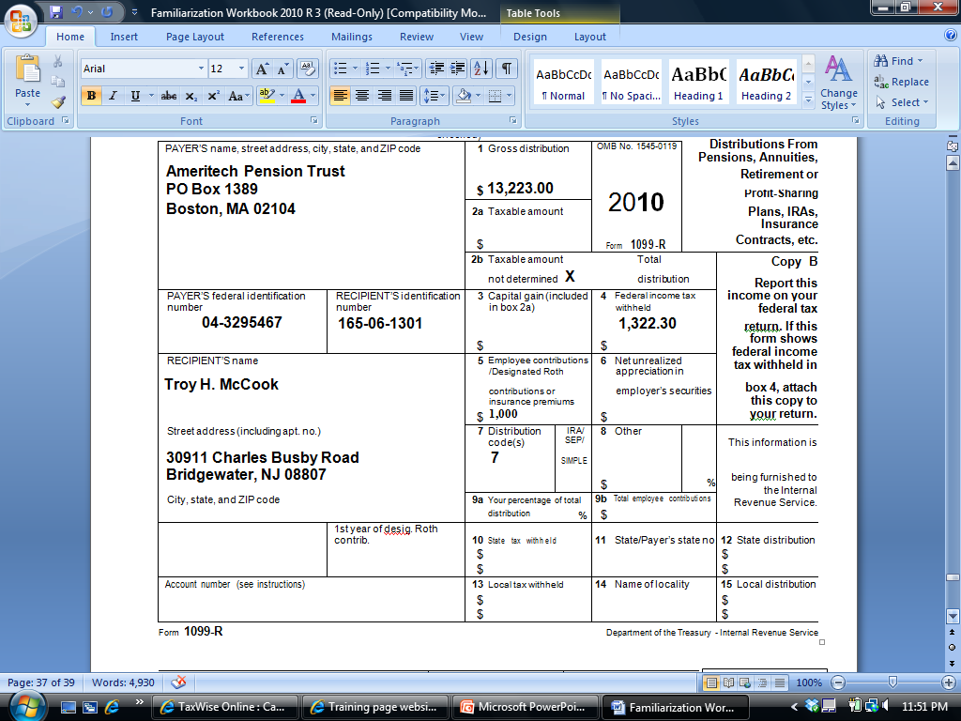
Sample 1099-R
8,223
2014
822
Diane Davis
210 Main Street
Bridgewater, NJ 08807
10,000
Notes:
This is a sample 1099-R showing how pension/annuity/IRA income is reported
17

Slide 18
1099-R Distributions
Taxability of distributions computed separately for each 1099-R
Gross distribution shown in Box 1
Taxable amount of distribution shown in Box 2a
If taxable amount not shown, must complete Simplified Method Worksheet to determine how much of distribution is taxable
Lump sum distribution
Shown to right of Box 2 on Form 1099-R “Total Distribution”
Employee contributions in Box 5 are normally the non-taxable portion of the yearly distribution. Box 5 + Box 2 = Box 1
For CSA Form 1099-R (Civil Services Retirement Benefits), the amount in box 5 is for health insurance premiums. Needs to be manually entered into Schedule A Medical Expenses
Notes:
18

Slide 19
Distributions
(cont’d)
Box 7 is checked if distribution is from an IRA/SEP/Simple plan
Employee contributions in Box 9b – the amount reported here is not taxable but must be allocated across expected life of pension
Used when completing Simplified Method Worksheet
Military pensions (taxable Federal, not NJ)
On 1099-R, check “Box 2” opposite Boxes 10 & 13 – takes income out of NJ
IRA contributions not taxed in NJ when distributed (after-tax contributions). Use NJ IRA Worksheet to calculate tax on IRA distribution if contributions are known
Notes:
19

Slide 20
TW – Distribution from Retirement Plan – Form 1099-R
If taxable amount not determined
& Box 2 not populated, must
complete Simplified Worksheet
Enter Payer ID. If TW
populates name & address,
verify. Changes frequently.
Total distribution
Check if IRA
Notes:
Open a 1099-R Distributions from Profit-Sharing, Retirement Plans, IRAs, etc. screen
Link from Line 16a on 1040 Page 1 (using arrow or F9) OR
Go directly to 1099-R by clicking on 1099R in Forms Tree
TW screen must match exact info from printed 1099-R form
Check whether 1099-R is for taxpayer or spouse
Enter Payer’s ID from 1099-R form
TW will populate Payer’s name & address based on ID if it can. Otherwise, type in
If Payer’s info is pre-populated from TW carry-forward data, still must check carefully to see if info has changed (address frequently does)
TW will populate Recipient’s SS #, name & address from Main Info screen
Enter data from printed 1099-R into same boxes on TW screen
If this is a total distribution, check box next to box 2
Be sure to enter any codes in Box 7. Also check IRA/SEP/Simple1099-R box if this is an IRA distribution
If Taxable Amount Not Determined box is checked & Taxable Amount in Box 2 is not populated, use Simplified Method Worksheet at bottom of screen to determine taxable amount for Federal
CLICK ON 1040 PAGE 1 IN FORMS TREE
TW will transfer gross amount of pension to 1040 Line 16a & taxable amount to Line 16b; if distribution is from an IRA (based on check in box 7), gross amount will transfer to Line 15a & taxable amount to Line 15b
20

Slide 21
TW – Distribution from Retirement Plan – Form 1099-R
(cont’d)
Pensions/IRA withdrawals that
do not qualify for NJ pension exclusion
Military pension from Defense Finance & Accounting
Railroad Retirement Box if RR pension
Notes:
Boxes in lower left corner are used to ensure that pensions are reported correctly on NJ 1040
Check Box 1 for pensions/IRA withdrawals that do not qualify for NJ pension exclusion (first $20,000)
Check Box 2 if military pension from Defense Finance & Accounting Service. NJ does not tax. Federal does tax
Box 3 is not used
Check Railroad Retirement Box if RR pension. NJ does not tax. Federal does tax
21

Slide 22
Distribution from Retirement Form 1099-R – TW Tips
Link to 1099-R & enter exact info from printed 1099-R form into TW
For total distributions, check Box next to Box 2
Enter any codes in Box 7
For IRA distributions - check IRA/SEP/Simple1099-R box
For code = 3 (disability) if taxpayer is below the company minimum retirement age, check Box under Boxes 7. (This will put the 1099-R amount as Wages on 1040 Line 7, rather than as Pension on 1040 Line 14)
If “Taxable Amount Not Determined” box is checked & Taxable Amount in Box 2 is not populated, use Simplified Method Worksheet at bottom of screen to determine taxable amount for Federal
Notes:
22

Slide 23
Distribution from Retirement Form 1099-R – TW Tips
(cont’d)
Boxes in lower left corner are used to ensure that pensions are reported correctly on NJ 1040
Check Box 1 for pensions/IRA withdrawals that do not qualify for NJ pension exclusion
Check Box 2 if military pension from Defense Finance & Accounting Service (NJ tax exempt)
Check Railroad Retirement box if RR pension (NJ tax exempt)
TW transfers gross amount of pension to 1040 Line 16a & taxable amount to Line 16b; if distribution is from an IRA (based on check in box 7), gross amount will transfer to Line 15a & taxable amount to Line 15b
Amounts from 1040 federal lines 16b transfer to NJ line 19a
Amounts from 1040 federal line 15b transfers to NJ IRA Worksheet and then to NJ line 19a after NJ IRA Worksheet is completed
Notes:
23

Slide 24
Pension & Annuity Partially Taxable Distribution - Simplified Method Worksheet
Used to determine nontaxable portion of pension/ annuity if taxable amount is not given in 1099-R Box 2a
Employee after-tax contribution divided by total number of expected payments
Used when:
“Taxable Amount Not Determined” box is checked on 1099-R
IRA box is not checked on 1099-R
Box 2a of 1099-R is not populated
If “Taxable Amount Not Determined” box is checked but Box 2a is populated, assume Box 2a value is correct
Compute on TW 1099-R Simplified Method Worksheet at bottom of 1099-R screen
Notes:
24

Slide 25
Pension & Annuity Partially Taxable Distribution - Simplified Method Worksheet
(cont’d)
Taxpayer needs to know:
Annuity starting date & taxpayer contribution to plan
Prior year cumulative tax-free amount if annuity started after 1986. If not available, assume $0
Pre-1987 starting date - tax exclusion can exceed cost & is available each year
1987 or later starting date - tax exclusion is limited to cost
Notes:
25

Slide 26
Pension & Annuity Distribution Simplified Method Special Case
Joint and survivor pension and primary annuitant dies before beginning to receive pension
At a later date, secondary annuitant starts to receive benefits from the pension
Must use secondary annuitant date of birth & date when secondary annuitant started receiving benefit in Simplified Method (instead of dates for primary annuitant)
Notes:
26

Slide 27
TW - Nontaxable Portion of Retirement Distribution – Simplified Method
Cost basis when pay-outs started (from 1099-R Box 9b)
Age when pay-outs started (not current age)
From prior year return or taxpayer
TW calculates tax-
exempt income
Use this worksheet to determine nontaxable portion of retirement distribution
Notes:
This worksheet used to determine non-taxable portion of the retirement distribution, based on taxpayer’s original contributions to pension/annuity (in 1099-R 9b). These contributions were taxed when contributed; therefore, they should not be taxed again on distribution. Contributions must be recovered equally over the course of the pension’s expected life; cannot all be recovered up front before taxable portion
Enter cost basis in plan when payouts started on Line 1 (from Box 9b of 1099-R)
Check age of primary recipient at starting date of payouts (NOT today’s age) on Line 2
Check appropriate box on Line 2 based on payout starting date
If a joint & survivor annuity, enter combined age of both people at starting date of payouts (NOT today’s ages)
Enter # of months for which payments were received in current year on Line 4
Enter amount received tax free in prior years on Line 5 (from last year’s return or taxpayer)
TW will calculate how much of amount can be excluded from income & how much will remain in the pension for future years’ calculations
Exclusion amount will be the same for all full years of pension distribution; could be different for first & last years of distribution since they may not be full years
27

Slide 28
TW-Retirement Income on 1040 Line 16
Total pension distribution
Total taxable distribution
Notes:
Line 16a includes Pensions, Annuities & 401K s
TW transfers total retirement distribution from 1099-R screen to 1040 Line 16a
TW transfers taxable portion of retirement distribution from 1099-R screen to 1040 Line 16b
28

Slide 29
Simplified Method Worksheet - TW Tips
Line 1 - Enter cost basis in plan when payouts started
From 1099-R Box 9b
Check age of primary recipient at starting date of payouts (NOT current age)
Check appropriate box based on payout starting date
If joint & survivor annuity, enter combined age of both people at starting date of payouts (NOT current ages)
Line 4 – Enter # of months for which payments were received in current year
Notes:
29

Slide 30
Simplified Method Worksheet - TW Tips
(cont’d)
Line 5 – Enter amount received tax free in prior years
From last year’s return or taxpayer
Line 6 - TW calculates how much of distribution amount can be excluded from income
Line 7 – TW calculates remaining cost in pension or annuity for future years’ calculations
Amount of employee contributions still not recovered tax free
Once remaining cost reaches 0, all distributions are taxable (for pension pay-outs starting in 1986 or later)
TW will calculate how much of total distribution is still taxable & populate on 1040 Line 16b
Box 1 of 1099-R minus Line 6 of Simplified Worksheet
Notes:
30

Slide 31
1099R Screen 1099 Distributions – Exclusion Worksheet
Types of distributions of retirement income may be excluded from taxable income
Rollovers (Line 1)
Public safety officer accident/health/long-term care insurance premiums (Line 4)
Tax-free exchanges (Line 5)
E.g. – Return of contributions paid into an annuity
Exclusion worksheet also used for other special cases
Distributions from IRAs when nondeductible contributions were made
Conversion from a traditional IRA to a Roth IRA
Notes:
31

Slide 32
Rollovers
Money transferred from one tax-deferred account into another (e.g. – 401k to IRA or IRA to another IRA)
Entries on tax documents and treatment in TW depend upon circumstances of transfer
Counselor needs to fully understand what occurred
Three common scenarios
Direct IRA trustee-to-trustee transfer
Direct rollover from a qualified retirement plan (Taxpayer does not receive money)
60-day indirect rollover (Taxpayer receives money)
Notes:
32

Slide 33
Direct IRA Trustee-to-Trustee Transfer
Transfer of assets from IRA under one trustee to IRA under a different trustee without taxpayer ever taking control of money
No limit on how many can be done in one year
Can be done electronically (receiving trustee requests from original trustee) or distribution check can be issued in name of receiving trustee (not in taxpayer’s name)
Not reported on 1099-R
Not a taxable event; nothing in TW
Receiving trustee does not issue a Form 5498 to show how much was received
Notes:
The easiest way for a taxpayer to transfer money from one trustee to another is to go to new trustee & ask for this to be done electronically
33

Slide 34
Direct Rollover from a Qualified Retirement Plan (TP Does Not Receive Money)
Transfer of assets from a qualified retirement plan (e.g. – 401k) into an IRA (or another qualified retirement plan) - TP does not receive money
Reported on 1099-R with Code G in Box 7
Enter 1099-R in TW as normal
TW will automatically exclude amount from taxable income based on code G in Box 7
Form 5498 may be issued by receiving plan with amount received in Box 2
Do nothing with Form 5498 in TW
Notes:
Situation could happen when you retire
34

Slide 35
Indirect 60-Day IRA Rollover (TP Receives Money)
Assets in IRA (or other qualified retirement plan) are liquidated, check made out to taxpayer, funds are re-deposited with another trustee
Original trustee reports distribution on 1099-R with code 7 in Box 7 (regular distribution)
Enter 1099-R in TW as normal
If re-deposited in another IRA within 60 days, considered non-taxable
However, cannot rollover money from either “from” or “to” IRA to any other IRA for 12 months
Manually tell TW to exclude from taxable income on Line 1 of Exclusion Worksheet on 1099R screen
TW transfers gross distribution & taxable amount to 1040 Lines 15a/b
TW checks rollover box on 1040 Line 15b
Link to rollover explanation page to describe circumstances of rollover
Notes:
This frequently happens when taxpayer goes to original trustee and closes out IRA. Then goes to a new trustee & opens a new IRA
35

Slide 36
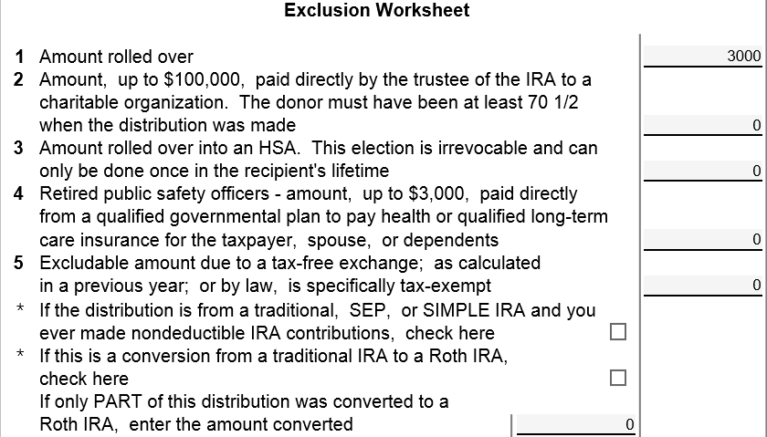
TW – 1099-R Rollover on Exclusion Worksheet (if TP Receives Money)
Amount rolled over
Notes:
If any of amount on 1099-R was rolled over into another retirement plan within the required 60 days, enter the roll-over amount on Exclusion Worksheet Line 1 of 1099R screen. TW will exclude from taxable income
36

Slide 37
TW-1040 Line 15b-Showing Rollover
TW checks, based on entry on Exclusion Worksheet Line 1
Link to IRA Rollover Explanation screen
Notes:
Once amount is entered into Exclusion Worksheet Line 1 on 1099-R screen, TW will automatically check rollover box on 1040 Line 15b
Link to IRA Rollover Explanation screen from Box “F9 to explain”
37

Slide 38
TW-IRA Rollover Explanation Screen
Notes:
LINK TO IRA ROLL-OVER EXPLANATION SHEET from “F9 to Explain” box on 1040 Line 15b
Document the details of the rollover, including original and receiving trustees and statement that transfer was done within 60 days
TW will exclude rollover amount from taxable income
38

Slide 39
TW-1040 Line 15–Total and Taxable Amounts
Total IRA distribution
Taxable amount after rollover
Notes:
TW will transfer total distribution from 1099-R to 1040 Line 15a
TW will subtract rolled over amount from total distribution & transfer amount left to be taxed to 1040 Line 15b
39

Slide 40
Rollover on Exclusion Worksheet – TW Tips
Enter rollover amount on Exclusion Worksheet Line 1 of 1099-R screen
TW will check box next to “F9 to explain” Box on 1040 Line 15B
Link to IRA RollOver Explanation screen from “F9 to explain” Box
Document details of the rollover, including original and receiving trustees and statement that transfer was done within 60 days
Notes:
40

Slide 41
Public Safety Officer Pension
When accident, health or long-term care insurance premiums are deducted directly from pension check, a former Public Safety Officer is allowed up to a $3,000 reduction in taxable income
This applies to both the federal and the NJ return
Enter on Exclusion Worksheet Line 4
TW will subtract the amount entered (up to $3,000) from the Total Distribution and populate Taxable Amount on 1040 Line 16b and NJ-1040 Line 19a
Any amount excluded does not need to be included on NJ-1040 Line 19b
Amounts entered on the Exclusion Worksheet Line 4 cannot also be included on Sch A
Notes:
How would we know? Client would have to disclose that they are public safety officer (Police, Fireperson, Rescue Squad, chaplain)
To avoid giving officer a double benefit, you cannot also deduct medical insurance premium on Sch A for these premiums
41

Slide 42
Tax-Free Exchanges
Certain distributions can be considered tax-free exchanges
Example – Return on contributions made to annuity
Must probe with taxpayer to really understand what 1099-R is showing
If part or all of distribution is really tax-free, enter amount on Exclusion Worksheet Line 5
TW will subtract exclusion amount from Total Distribution and populate Taxable Amount on 1040 Line 16b
Notes:
You can recognize return of contributions made to an annuity by:
1099-R with amount in Box 1 (Gross Amount) & Box 5 (Employee Contributions Designated Roth or Insurance Premiums)
Nothing may be checked in boxes for “Taxable Amount Not Determined” or “Total Distribution”
Box 7 code = 7 (Normal Distribution)
42

Slide 43
Other Uses for Exclusion Worksheet
If distribution is from an IRA that included non-deductible contributions (taxed at time of contribution)
Refer to an experienced counselor
Check box under Exclusion Worksheet Line 5
Form 8606 Non-deductible IRAs Part I needed to determine taxable amount of distribution
TaxWise will automatically add Form 8606 to Forms Tree when Box under Line 5 is checked; do not add 8606 from Forms List
See TaxPrep4Free.org Preparer page Special Topics Document “IRA Non-Deductible Contributions and Distributions”
Notes:
43

Slide 44
Other Uses for Exclusion Worksheet
(cont’d)
For conversion of a traditional IRA (with no non-deductible contributions) into a Roth IRA, distribution is taxable
Check box under Exclusion Worksheet Line 5
If only part of distribution was converted to Roth IRA, enter amount converted
If non-deductible contributions made to IRA, Form 8606 Nondeductible IRAs Part II needed
Out of Scope
Notes:
44

Slide 45
TW- Other Uses of Exclusion Worksheet
Public Safety Officer Insurance
Distribution from IRA with non-deductible contributions
Traditional IRA to Roth conversion
Partial conversion
Notes:
If distribution is from an IRA and non-deductible contributions were previously made to that IRA, some of the distribution may not be taxable
Determining amount taxable can be complex, so refer to an experienced counselor
Check Box under Line 5 on Exclusion Worksheet
Use Forms List icon at top of 1099-R screen to add Form 8606 Nondeductible IRA to Forms Tree
Complete Form 8606 Part I
If the distribution was for a conversion from a traditional IRA to a Roth IRA
Check box under Line 5 on Exclusion Worksheet
If only part of the distribution was converted to a Roth IRA and the rest was kept by taxpayer, enter amount converted
45

Slide 46
NJ Retirement Income Topics
Rules on taxability of NJ retirement income
NJ 1040 Lines 19a
NJ IRA Worksheet
NJ 1040 Line 19b
3-year rule for pensions
NJ pension exclusion
NJ other retirement income exclusions

Slide 47
Rules on Taxability Of Retirement Income - NJ
(cont’d)
Contribution | Taxable at Contribution | Taxability of Distribution
Employer contributions | N/A | YES
Employee contributions paid with pre-tax dollars to 401K | NO | YES
Employee contributions paid with after-tax dollars (including IRA) | YES | NO
Earnings on both employer & employee contributions | N/A | YES
Notes:
Summary of taxability of different parts of retirement income

Slide 48
NJ IRA Worksheet
IRA distributions are taxed in NJ except for the portion of the total IRA that represents taxpayer contributions
Portion of the IRA that was contributions is spread over a period of distribution years
The NJ IRA Worksheet is used to make this calculation
Taxpayer must know total contributions (usually not the case)

Slide 49
General Rules for IRA Worksheet
There must be an IRA Worksheet for each IRA distribution (1099-R with IRA box checked) *
Use the “+” in Forms Tree to add additional Worksheet
Enter 1,2,3… in second box at the top as additional Worksheets are added
Enter info for after-tax contributions (if known) by completing the red fields (Part I for first year distributions – Part II for second and later years)
If after-tax contributions are not known, take the red out of the fields that are red
*TW will not include IRA distribution amount in NJ income until
IRA Worksheet is completed

Slide 50
NJ IRA Worksheet contributions known – First Year of Withdrawal
Line 1 – Enter value of IRA at end of tax year
Line 2 – Total distribution – calculated field from 1099-R
Line 3 – Calculated
Line 4a – Enter total IRA contributions previously taxed
Rest of lines in Part 1 calculated
Line 8 – Excludable portion of distribution
TW transfers taxable portion of distribution from Line 7 to NJ 1040 Line 19

Slide 51
TW IRA Withdrawal Worksheet – First Year of Withdrawal
Enter copy number
Complete lines 1 and 4a if information known for 1st year withdrawal
Taxable amount of this year’s withdrawal
Excludable amount of this year’s withdrawal
Notes:
Demo how to bring up the Worksheet and to add multiple copies
Enter copy number
If after-tax contributions are known, complete Lines 1 and 4a for year 1
If after-tax contributions are not known (most cases), take the red out of the red fields
If after-tax contributions are entered on IRA Worksheet, make note in Taxpayer Diary to remind next year’s counselor to continue to use IRA Worksheet to determine taxable amount of IRA distribution (since this is a rare case)

Slide 52
NJ IRA Worksheet contributions known – Second & Subsequent Years
Part I Line 1 – Enter value of IRA at end of tax year
Part II Lines a, b, c – Enter values from last year’s IRA Worksheet
Screen tells you what line to reference from last year
Part II Line f – Enter IRA contributions during current tax year
TW calculates rest of lines in Part II
TW transfers total unrecovered contributions calculated in Part II to Part I Line 4b
Line 8 – Excludable portion of distribution
TW transfers taxable portion of distribution from Line 7 to NJ 1040 Line 19a and the excludable portion to Line 19b

Slide 53
TW NJ IRA Withdrawal Worksheet – Second and Later Years
Enter value of IRA on 12/31
Taxable & excludable amounts of this year’s withdrawal
Enter amounts for Lines a, b & c from prior year’s IRA Worksheet
Enter IRA contributions this year
Notes:
Enter copy number
If this is second or later year of withdrawals from this IRA, enter Part 1 Line 1 & Part II Lines a, b, c, & f
Form tells you what line you should look at on prior year’s IRA Worksheet to get the figures for Part II Lines a, b, c
Enter contributions to IRA during current tax year on Part II Line f
If after-tax contributions are entered on IRA Worksheet, make note in Taxpayer Diary to remind next year’s counselor to continue to use IRA Worksheet to determine taxable amount of IRA distribution (since this is a rare case)

Slide 54
NJ 1040 Line 19b – Adjustments Excludable Pensions, Annuities, & IRA Withdrawals
NJ 1040 Line 19b should include the excludable portion of any distribution you received from a contributory pension, annuity, or IRA. This is the amount that represents your previously taxed contributions to the plan
For IRAs, if NJ IRA Worksheet is completed, TW will automatically put non-taxable amount of IRA distribution on NJ 1040 Line 19b
For pension distributions that have a NJ non-taxable portion, you must make a manual adjustment to line 19b

Slide 55
NJ 1040 Line 19b – Adjustments Excludable Pensions, Annuities, & IRA Withdrawals
(cont’d)
Attach a scratch pad to NJ Line 19b
Add the non-taxable amount to the scratch pad
Include:
Non-taxable amounts calculated on the Simplified Method Worksheet
The difference amount anytime the 1099-R Box 1 is different than Box 2a
The full amount received when using the Three-Year Rule until all of the contributions are recovered
Do not includes pensions that are not taxed in NJ such as military pensions, disability pensions under 65, and Railroad Retirement Tier 2 pensions
Make Line 19b adjustments as you are entering pensions into TaxWise
Refer to TaxPrep4Free.org “NJ Special Handling” document for details

Slide 56
TW- Retirement Income on NJ 1040 Lines 19a & 19b after IRA Worksheet Completed
Now includes pension + IRA income
Excludable portion of IRA distribution

Slide 57
TW- Line 19b Scratch Pad for Excludable Pension Income

Slide 58
TW- NJ 1040 Line 19b After IRA Worksheet Completed & Excludable Pension Scratch Pad
Excludable portion of IRA distribution & pension

Slide 59
NJ 3-Year Rule for Pensions Qualifications
May use NJ 3-Year Rule if:
Both you and employer contributed to plan
Will recover your contributions within 36 months of 1st payment from plan
May exclude all pension distributions from income until payments = contributions
If pension started in middle of year, could be partially taxable in last year of exclusion
Pensions only – Use IRA Worksheet for IRAs
See NJ Special Handling (Link from TaxPrep4Free.org Preparer page) for details on entering 3-year rule.
Notes:
To use the 3-year rule you must have started using the rule on the first year you took the distribution (or be able to go back and amend prior returns to show this)
This may be useful for people who retire before 62 ½ because they wouldn’t be eligible for other NJ pension exclusions yet
We do not see this situation very often because:
Taxpayer must have contributed to pension plan along with employer
Must be just starting to collect pension
Must be able to recover all employee contributions within 3 years of first pension payment
Pension exclusion & unclaimed pension exclusion may be enough to exclude all pension income from NJ tax
Check prior year’s NJ return and/or ask taxpayer to see if taxpayer was using 3-year rule for pension last year. If so, use following instructions to continue adjusting NJ return until pension payments = employee contributions.
Make a note in Taxpayer Diary that taxpayer was using 3-year rule for pension, so that next year’s counselor will know to continue using until payments = contributions

Slide 60
NJ Pension Exclusion Qualifications
You &/or spouse/CU partner 62 years+ or disabled or blind on last day of year
If only 1 partner qualifies, can still claim up to maximum pension exclusion. Only retirement income of qualified partner can be excluded
Total income from NJ 1040 Line 26 $100K or less

Slide 61
NJ Pension Exclusion Annual Amounts
Based on filing status:
$20K – MFJ
$15K – Single, HOH, QW
$10K – MFS
Maximum exclusion cannot exceed total Pension, Annuity & IRA Withdrawal amount on NJ 1040 Line 19a
Notes:
Pension exclusion claimed on NJ 1040 Line 27a may be less than the maximum exclusion because total Pension, Annuity & IRA Withdrawal amount on Line 19a is less than the maximum

Slide 62
Other Retirement Income Exclusions - NJ1040 Line 27b
2 Parts to Other Retirement Income Exclusions
Unclaimed portion of your Pension Exclusion (NJ 1040 line 27a)
Special exclusion for taxpayers who are unable to receive SS or RR benefits
Each part has different eligibility requirements

Slide 63
Other Retirement Income Exclusions: Unclaimed Pension Exclusion
Did not use maximum Pension Exclusion
You &/or spouse/CU partner 62 years+
Total income from NJ 1040 Line 26 $100K or less
Income from wages, net profit from business, partnership, S corp. income </= $3K
Amount will be maximum pension exclusion minus pension exclusion claimed on NJ 1040 Line 27a
Notes:
Income from wages, net profit from business is made up of NJ 1040 Lines 14+17+20 +21

Slide 64
NJ Other Retirement Income Exclusions: For Taxpayers Unable to Receive SS/RR Benefits
Not related to Pension Exclusion & may claim whether or not you use maximum Pension Exclusion
Exclusion amounts $6K – MFJ, HOH, QW; $3K – Single, MFS
You &/or spouse/CU partner 62 years+
Unable to receive SS/RR benefits, but would have been eligible for benefits had you fully participated in either program
Must answer questions on Line 10 of Other Retirement Income Exclusion Worksheet

Slide 65
Pension (Line 19) & Exclusions (Line 27a & 27b)– NJ 1040
Note: TW calculates 27a and 27b automatically
Even though pension exclusion can be up to $20K, it cannot be > pension income on Line 19a
Notes:
NJ has two lines for Pension Exclusions which are calculated by TW--1040 line 27A and 27b
Note: Line 27a Pension Exclusion (calculated field) cannot exceed line 19 (calculated field). TW takes care of this

Slide 66
NJ TW Other Retirement Income Exclusion Worksheet
Notes:
Must answer questions in red here
Other Retirement Income Exclusion Worksheet (NJ Ret Wkt) in red at bottom of Forms Tree
Reasons why you may not be eligible for SS:
Work for the state and you get something like SS
Never had enough SS credits
No SS#, even if you have an ITN

Slide 67
Other Topics Relating to Retirement Income
Special topics relating to retirement income to be discussed on subsequent slides
Railroad Retirement Benefits Tier II
Disability income reported on 1099-R
Prior to retirement age
After retirement age
IRA Penalties
Non-deductible contributions to an IRA
Tracking contributions to establish cost basis
Distributions from IRAs containing non-deductible contributions
Notes:
This is just a summary page to introduce some other special topics relating to retirement income that we will be discussing on subsequent slides.
Do not discuss any of these topics in detail now. Just mention them so students will know what is coming
67

Slide 68
Railroad Tier 2 Benefits (Pension Equivalent)
Railroad Retirement Tier 2 (Pub 575)
RRB-1099-R - Green Form
Same rules as pensions
Use Pub 4012 Page D-25 for instructions where to enter data in TW
RRB-1099-R Pension (not taxable in NJ)
On 1099R screen, put check in “Railroad Retirement” box opposite Box 13 – TaxWise takes income out of NJ income
Notes:
Show students Page D-25 in Pub 4012
Show students Railroad Retirement box on Form 1099-R screen
68

Slide 69
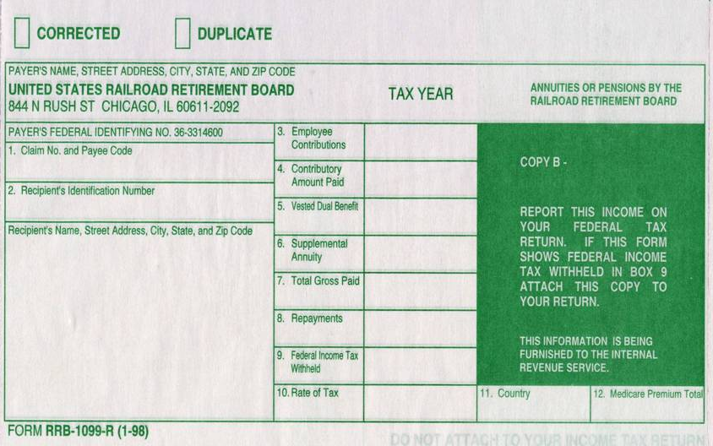
Sample Railroad Retirement (RR) Benefits Tier 2
1099-R Box 9b
1099-R Box 1
1099-R Box 4
Sch A Medical
Notes:
This is a sample 1099-R for Railroad Retirement Benefits – Tier 2
Use 1099R screen to enter RR Benefits
69

Slide 70
Railroad Retirement Benefits Tier 2
Railroad Retirement Box
Notes:
Click on Railroad Retirement Box next to Box 15 on 1099R screen
TW will exclude the RR income from NJ income
70

Slide 71
Disability Income Reported on 1099-R
If disability income is reported on 1099-R:
1099-R, Box 2 shows taxable amount
1099-R, Code 3 in Box 7 indicates disability
Before taxpayer has reached minimum retirement age (as defined by employer), income is considered wages, not pension
In TW, check box below Box 7 on 1099-R screen so TW will include as wages on 1040 Line 7
After taxpayer reaches minimum retirement age, income is reported as taxable pension on 1040 Line 16b
Notes:
PREVIOUSLY COVERED UNDER WAGES
Check Box below Box 7 on 1099R SCREEN. TW will include as wages on 1040 Line 7, rather than as pension income on 1040 Line 16b
Show where this box is on TW screen
Note: Normal retirement age is determined by employer. Counselor can find out by asking client. If client doesn’t know, can call employer
71

Slide 72
Disability Income on Form 1099-R
2014
Taxable amount
Code 3 is Disability
3
Notes:
Sample 1099-R showing disability income. If taxpayer is below retirement age, the amount in Box 2a should transfer to 1040 Line 7 Wages, rather than 1040 Line 16b Taxable Pension
72

Slide 73
TW - Distribution from Retirement Plan – Form 1099-R
Check this box if pre-retirement age disability
Code for disability
Notes:
If code in Box 7 is 3 (person on disability under retirement age), check Box under Boxes 7/8. TW will put the 1099-R amount as Wages on 1040 Line 7, rather than as Pension on 1040 Line 16
73

Slide 74
NJ Disability Income
Disability age for NJ is 65
Income NJ taxable > 65
Income not NJ taxable < 65
If taxpayer’s company normal retirement age is below 65 and taxpayer is between that age and 65
Adjustment required to NJ line 19 using scratch pad to remove from taxable pension

Slide 75
IRA Penalties
Early distribution penalty (prior to 59½ )
Additional tax of 10%
Certain exemptions to penalty– Codes 2, 3 or 4 in 1099-R Box 7 – don’t need Form 5329. TWO handles automatically
Code 1 in 1099-R, Box 7 - need Form 5329 Additional Taxes on Qualified Plans to determine if there is an exception to additional tax (taxpayer will advise). Select appropriate code
TW calculates any penalty, per 1099-R input, & carries to 1040 Line 58 in “Other Tax” section
Excess contributions penalty – Out of Scope
Additional tax - 6% of excess contribution
Notes:
3 different types of IRA penalties
Early distribution penalty – 10% of withdrawal
Excess contributions penalty – 6% of excess contribution
Failure to take Required Minimum Distribution (RMD) penalty – 50% of amount of RMD not taken
75

Slide 76
IRA Penalties
(cont’d)
Failure to take full Required Minimum Distribution (RMD) penalty
Penalty is 50% of RMD amount not taken
Counselor not expected to review all plans and verify that required distributions were taken
Can request waiver if:
Taxpayer missed taking all or part of RMD
Shortfall in amount of distribution due to reasonable error
Taxpayer is taking reasonable steps to remedy shortfall
Use Form 5329 Part VIII to request waiver
Separate 5329 form for taxpayer and spouse
See specific instructions in Special Topic document on TaxPrep4Free.org Preparer page
Notes:
76

Slide 77
Form 5329 – Exclusions to 1099-R Code 1 Penalty for Early Distribution
Pub 4012 Tab H
Form 5329
Only Part I is in scope
Check box under Box 7 on 1099-R to “Force Form 5329”
Sample exclusion codes
03 – Distribution due to total and permanent disability
05 – Qualified retirement plan distributions up to (1) the amount you paid for unreimbursed medical expenses during the year minus (2) 7.5% of your adjusted gross income for the year.
08 – IRA distributions made for higher education expenses.
09 – IRA distributions made for purchase of a first home, up to $10,000.
12 – Other (e.g.-Distributions incorrectly indicated as early distributions by code 1, J, or S in box 7 of Form 1099-R. Include on Line 2 the amount you received when you were age 59½ or older)
Notes:
Bring up Form 5329 by checking box under Box 7 on 1099-R. Do not bring up 5329 by adding from Forms List icon at top of screen
Always explore circumstances of an early distribution with taxpayer to determine if there is a possible exemption to the 10% penalty
77

Slide 78
TW-Distribution from Retirement Plan – Form 1099-R
Check this box to force
Form 5329 for exceptions
Early withdrawal penalty
code
Notes:
If 1099-R has code 1 in Box 7, taxpayer will be charged a 10% penalty for an early withdrawal
If taxpayer may be qualified for an exception to early distribution penalty because money was used for certain qualifying expenses, force Form 5329 to be added to Forms Tree by checking box under Box 7
78

Slide 79
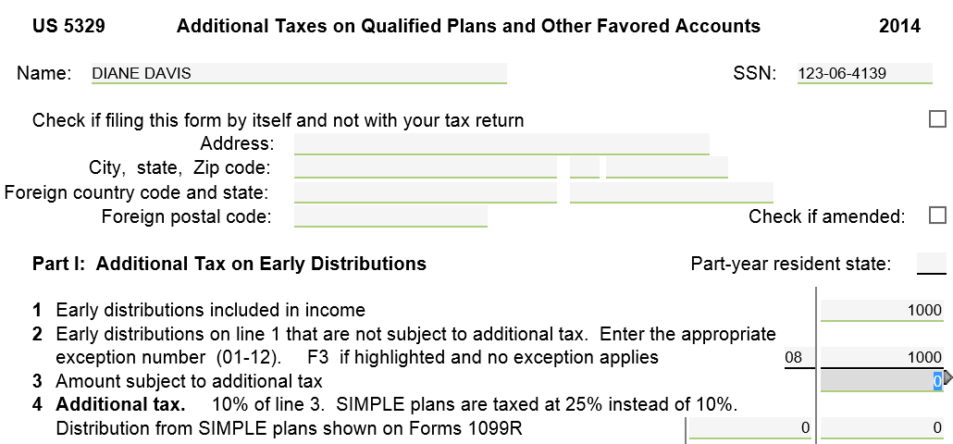
TW Form 5329 – Additional Taxes on Qualified Plans
Pub 4012 Tab H
Amount not subject to
additional tax
Pub 4012 Page H-2 for exception codes
Notes:
If Code 1 in Box 7 of 1099-R and Form 5329 added to Forms Tree:
TW populates Part I Line 1 of Form 5329 Early distributions included in income
Enter info on Part I Line 2 early distributions that are not subject to additional tax
To get appropriate code, look in Pub 4012 Page H-2
Enter amount that should be exempted from 10% penalty on early distribution
79

Slide 80
Form 5329 for Waiver for Failure to Take RMD
(cont’d)
RMD
Amount actually taken
Link to Explanation form; TW
checks box once form is completed
Amount of requested waiver
Notes:
80

Slide 81
Explanation for Request of Waiver of Tax
(cont’d)
Notes:
81

